Slide 1
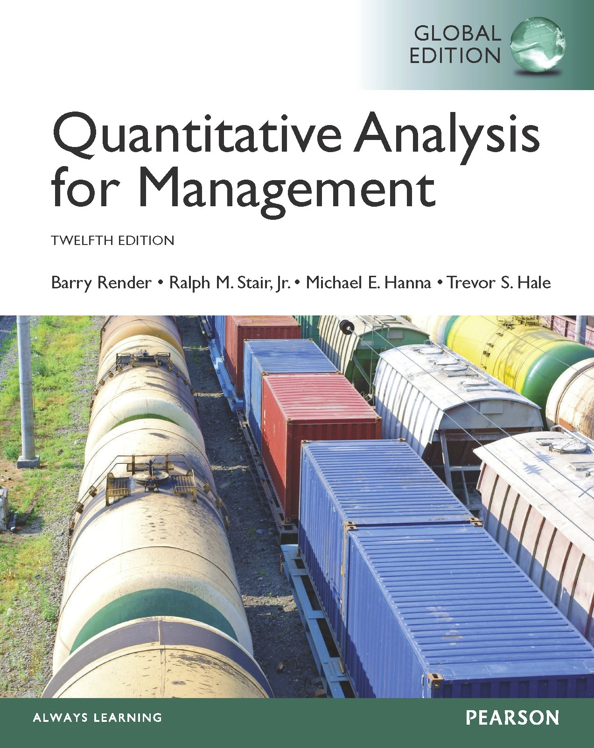
Linear Programming Models: Graphical and Computer Methods
7
To accompany Quantitative Analysis for Management, Twelfth Edition, Global Edition,
by Render, Stair, Hanna and Hale
Power Point slides created by Jeff Heyl
Copyright ©2015 Pearson Education, Inc.

Slide 2
LEARNING OBJECTIVES
After completing this chapter, students will be able to:
Understand the basic assumptions and properties of linear programming (LP).
Graphically solve any LP problem that has only two variables by both the corner point and isoprofit line methods.
Understand special issues in LP such as infeasibility, unboundedness, redundancy, and alternative optimal solutions.
Understand the role of sensitivity analysis.
Use Excel spreadsheets to solve LP problems.

Slide 3
CHAPTER OUTLINE
7.1 Introduction
7.2 Requirements of a Linear Programming Problem
7.3 Formulating LP Problems
7.4 Graphical Solution to an LP Problem
7.5 Solving Flair Furniture’s LP Problem using QM for Windows, Excel 2013, and Excel QM
7.6 Solving Minimization Problems
7.7 Four Special Cases in LP
7.8 Sensitivity Analysis

Slide 4
Introduction
Many management decisions involve making the most effective use of limited resources
Linear programming (LP)
Widely used mathematical modeling technique
Planning and decision making relative to resource allocation
Broader field of mathematical programming
Here programming refers to modeling and solving a problem mathematically

Slide 5
Requirements of a Linear Programming Problem
Four properties in common
Seek to maximize or minimize some quantity (the objective function)
Restrictions or constraints are present
Alternative courses of action are available
Linear equations or inequalities

Slide 6
LP Properties and Assumptions
TABLE 7.1
PROPERTIES OF LINEAR PROGRAMS
1. One objective function
2. One or more constraints
3. Alternative courses of action
4. Objective function and constraints are linear – proportionality and divisibility
5. Certainty
6. Divisibility
7. Nonnegative variables

Slide 7
Formulating LP Problems
Developing a mathematical model to represent the managerial problem
Steps in formulating a LP problem
Completely understand the managerial problem being faced
Identify the objective and the constraints
Define the decision variables
Use the decision variables to write mathematical expressions for the objective function and the constraints

Slide 8
Formulating LP Problems
Common LP application – product mix problem
Two or more products are produced using limited resources
Maximize profit based on the profit contribution per unit of each product
Determine how many units of each product to produce

Slide 9
Flair Furniture Company
Flair Furniture produces inexpensive tables and chairs
Processes are similar, both require carpentry work and painting and varnishing
Each table takes 4 hours of carpentry and 2 hours of painting and varnishing
Each chair requires 3 of carpentry and 1 hour of painting and varnishing
There are 240 hours of carpentry time available and 100 hours of painting and varnishing
Each table yields a profit of $70 and each chair a profit of $50

Slide 10
Flair Furniture Company
The company wants to determine the best combination of tables and chairs to produce to reach the maximum profit
TABLE 7.2
 | HOURS REQUIRED TO PRODUCE 1 UNIT
DEPARTMENT | (T) TABLES | (C) CHAIRS | AVAILABLE HOURS THIS WEEK
Carpentry | 4 | 3 | 240
Painting and varnishing | 2 | 1 | 100
Profit per unit | $70 | $50

Slide 11
Flair Furniture Company
The objective is
Maximize profit
The constraints are
The hours of carpentry time used cannot exceed 240 hours per week
The hours of painting and varnishing time used cannot exceed 100 hours per week
The decision variables are
T = number of tables to be produced per week
C = number of chairs to be produced per week

Slide 12
Flair Furniture Company
Create objective function in terms of T and C
Maximize profit = $70T + $50C
Develop mathematical relationships for the two constraints
For carpentry, total time used is
(4 hours per table)(Number of tables produced) + (3 hours per chair)(Number of chairs produced)
First constraint is
Carpentry time used ≤ Carpentry time available
4T + 3C ≤ 240 (hours of carpentry time)

Slide 13
Flair Furniture Company
Similarly
Painting and varnishing time used ≤ Painting and varnishing time available
2 T + 1C ≤ 100 (hours of painting and varnishing time)
This means that each table produced requires two hours of painting and varnishing time
Both of these constraints restrict production capacity and affect total profit

Slide 14
Flair Furniture Company
The values for T and C must be nonnegative
T ≥ 0 (number of tables produced is greater than or equal to 0)
C ≥ 0 (number of chairs produced is greater than or equal to 0)
The complete problem stated mathematically
Maximize profit = $70T + $50C
subject to
4T + 3C ≤ 240 (carpentry constraint)
2T + 1C ≤ 100 (painting and varnishing constraint)
T, C ≥ 0 (nonnegativity constraint)

Slide 15
Graphical Solution to an LP Problem
Easiest way to solve a small LP problems is graphically
Only works when there are just two decision variables
Not possible to plot a solution for more than two variables
Provides valuable insight into how other approaches work
Nonnegativity constraints mean that we are always working in the first (or northeast) quadrant of a graph

Slide 16
Graphical Representation of Constraints
FIGURE 7.1 – Quadrant Containing All Positive Values
C
100 –
–
80 –
–
60 –
–
40 –
–
20 –
–
This Axis Represents the Constraint T ≥ 0
Number of Chairs
This Axis Represents the Constraint C ≥ 0
| | | | | | | | | | | |
0 20 40 60 80 100
T
Number of Tables

Slide 17
Graphical Representation of Constraints
The first step is to identify a set or region of feasible solutions
Plot each constraint equation on a graph
Graph the equality portion of the constraint equations
4T + 3C = 240
Solve for the axis intercepts and draw the line

Slide 18
Graphical Representation of Constraints
When Flair produces no tables, the carpentry constraint is:
4(0) + 3C = 240
3C = 240
C = 80
Similarly for no chairs:
4T + 3(0) = 240
4T = 240
T = 60
This line is shown on the following graph

Slide 19
Graphical Representation of Constraints
FIGURE 7.2 – Graph of Carpentry Constraint Equation
C
100 –
–
80 –
–
60 –
–
40 –
–
20 –
–
(T = 0, C = 80)
Number of Chairs
(T = 60, C = 0)
| | | | | | | | | | | |
0 20 40 60 80 100
T
Number of Tables

Slide 20
Graphical Representation of Constraints
FIGURE 7.3 – Region that Satisfies the Carpentry Constraint
Any point on or below the constraint plot will not violate the restriction
Any point above the plot will violate the restriction
C
100 –
–
80 –
–
60 –
–
40 –
–
20 –
–
Number of Chairs
(30, 40)
(70, 40)
(30, 20)
| | | | | | | | | | | |
0 20 40 60 80 100
T
Number of Tables

Slide 21
Graphical Representation of Constraints
The point (30, 40) lies on the line and exactly satisfies the constraint
4(30) + 3(40) = 240
The point (30, 20) lies below the line and satisfies the constraint
4(30) + 3(20) = 180
The point (70, 40) lies above the line and does not satisfy the constraint
4(70) + 3(40) = 400

Slide 22
Graphical Representation of Constraints
FIGURE 7.4 – Region that Satisfies the Painting and Varnishing Constraint
C
100 –
–
80 –
–
60 –
–
40 –
–
20 –
–
(T = 0, C = 100)
Number of Chairs
(T = 50, C = 0)
| | | | | | | | | | | |
0 20 40 60 80 100
T
Number of Tables

Slide 23
Graphical Representation of Constraints
To produce tables and chairs, both departments must be used
Find a solution that satisfies both constraints simultaneously
A new graph shows both constraint plots
The feasible region is where all constraints are satisfied
Any point inside this region is a feasible solution
Any point outside the region is an infeasible solution

Slide 24
Graphical Representation of Constraints
FIGURE 7.5 – Feasible Solution Region
C
100 –
–
80 –
–
60 –
–
40 –
–
20 –
–
Painting/Varnishing Constraint
Number of Chairs
Feasible Region
Carpentry Constraint
| | | | | | | | | | | |
0 20 40 60 80 100
T
Number of Tables

Slide 25
Graphical Representation of Constraints
For the point (30, 20)
Carpentry constraint | 4T + 3C ≤ 240 hours available (4)(30) + (3)(20) = 180 hours used
Painting constraint | 2T + 1C ≤ 100 hours available (2)(30) + (1)(20) = 80 hours used
✓
✓
For the point (70, 40)
Carpentry constraint | 4T + 3C ≤ 240 hours available (4)(70) + (3)(40) = 400 hours used
Painting constraint | 2T + 1C ≤ 100 hours available (2)(70) + (1)(40) = 180 hours used
✗
✗

Slide 26
Graphical Representation of Constraints
For the point (50, 5)
Carpentry constraint | 4T + 3C ≤ 240 hours available (4)(50) + (3)(5) = 215 hours used
Painting constraint | 2T + 1C ≤ 100 hours available (2)(50) + (1)(5) = 105 hours used
✓
✗

Slide 27
Isoprofit Line Solution Method
Find the optimal solution from the many possible solutions
Speediest method is to use the isoprofit line
Starting with a small possible profit value, graph the objective function
Move the objective function line in the direction of increasing profit while maintaining the slope
The last point it touches in the feasible region is the optimal solution

Slide 28
Isoprofit Line Solution Method
Choose a profit of $2,100
The objective function is
$2,100 = 70T + 50C
Solving for the axis intercepts, draw the graph
Obviously not the best possible solution
Further graphs can be created using larger profits
The further we move from the origin, the larger the profit
The highest profit ($4,100) will be generated when the isoprofit line passes through the point (30, 40)

Slide 29
Isoprofit Line Solution Method
FIGURE 7.6 – Profit line of $2,100
C
100 –
–
80 –
–
60 –
–
40 –
–
20 –
–
Number of Chairs
$2,100 = $70T + $50C
(30, 0)
| | | | | | | | | | | |
0 20 40 60 80 100
T
Number of Tables

Slide 30
Isoprofit Line Solution Method
FIGURE 7.7 – Four Isoprofit Lines
C
100 –
–
80 –
–
60 –
–
40 –
–
20 –
–
$3,500 = $70T + $50C
$2,800 = $70T + $50C
Number of Chairs
$2,100 = $70T + $50C
$4,200 = $70T + $50C
| | | | | | | | | | | |
0 20 40 60 80 100
T
Number of Tables

Slide 31
Isoprofit Line Solution Method
FIGURE 7.8 – Optimal Solution
C
100 –
–
80 –
–
60 –
–
40 –
–
20 –
–
Maximum Profit Line
Number of Chairs
Optimal Solution Point
(T = 30, C = 40)
$4,100 = $70T + $50C
| | | | | | | | | | | |
0 20 40 60 80 100
T
Number of Tables

Slide 32
Corner Point Solution Method
The corner point method for solving LP problems
Look at the profit at every corner point of the feasible region
Mathematical theory is that an optimal solution must lie at one of the corner points or extreme points

Slide 33
Corner Point Solution Method
FIGURE 7.9 – Four Corner Points of the Feasible Region
C
100 –
–
80 –
–
60 –
–
40 –
–
20 –
–
(0, 80)
Number of Chairs
(?)
(50, 0)
| | | | | | | | | | | |
0 20 40 60 80 100
(0, 0)
T
Number of Tables

Slide 34
Corner Point Solution Method
Solve for the intersection of the two constraint lines
Using the elimination method to solve simultaneous equations method, select a variable to be eliminated
Eliminate T by multiplying the second equation by –2 and add it to the first equation
– 2(2T + 1C = 100) = – 4T – 2C = –200
4T + 3C = 240 (carpentry)
– 4T – 2C = –200 (painting)
C = 40

Slide 35
Corner Point Solution Method
Substitute C = 40 into either equation to solve for T
Thus the corner point is (30, 40)
4T + 3(40) = 240
4T + 120 = 240
4T = 120
T = 30
TABLE 7.3 – Feasible Corner Points and Profits
NUMBER OF TABLES (T) | NUMBER OF CHAIRS (C) | PROFIT = $70T + $50C
0 | 0 | $0
50 | 0 | $3,500
0 | 80 | $4,000
30 | 40 | $4,100
Highest profit – Optimal Solution

Slide 36
Slack and Surplus
Slack is the amount of a resource that is not used
For a less-than-or-equal constraint
Slack = (Amount of resource available) – (Amount of resource used)
Flair decides to produce 20 tables and 25 chairs
4(20) + 3(25) = 155 (carpentry time used)
240 = (carpentry time available)
240 – 155 = 85 (Slack time in carpentry)

Slide 37
Slack and Surplus
At the optimal solution, slack is 0 as all 240 hours are used
Slack is the amount of a resource that is not used
For a less-than-or-equal constraint
Slack = (Amount of resource available) – (Amount of resource used)
Flair decides to produce 20 tables and 25 chairs
4(20) + 3(25) = 155 (carpentry time used)
240 = (carpentry time available)
240 – 155 = 85 (Slack time in carpentry)

Slide 38
Slack and Surplus
Surplus is used with a greater-than-or-equal-to constraint to indicate the amount by which the right-hand side of the constraint is exceeded
Surplus = (Actual amount) – (Minimum amount)
New constraint
T + C ≥ 42
If T = 20 and C = 25, then
20 + 25 = 45
Surplus = 45 – 42 = 3

Slide 39
Summaries of Graphical Solution Methods
TABLE 7.4
ISOPROFIT METHOD
1. Graph all constraints and find the feasible region.
2. Select a specific profit (or cost) line and graph it to find the slope.
3. Move the objective function line in the direction of increasing profit (or decreasing cost) while maintaining the slope. The last point it touches in the feasible region is the optimal solution.
4. Find the values of the decision variables at this last point and compute the profit (or cost).
CORNER POINT METHOD
1. Graph all constraints and find the feasible region.
2. Find the corner points of the feasible reason.
3. Compute the profit (or cost) at each of the feasible corner points.
4. Select the corner point with the best value of the objective function found in Step 3. This is the optimal solution.

Slide 40
Solving Flair Furniture’s LP Problem
Most organizations have access to software to solve big LP problems
There are differences between software implementations, the approach is basically the same
With experience with computerized LP algorithms, it is easy to adjust to minor changes

Slide 41
Using QM for Windows
Select the Linear Programming module
Specify the number of constraints (non-negativity is assumed)
Specify the number of decision variables
Specify whether the objective is to be maximized or minimized
For Flair Furniture there are two constraints, two decision variables, and the objective is to maximize profit

Slide 42
Using QM for Windows
PROGRAM 7.1A – QM for Windows Linear Programming Computer Input Screen

Slide 43
Using QM for Windows
PROGRAM 7.1B – QM for Windows Data Input

Slide 44
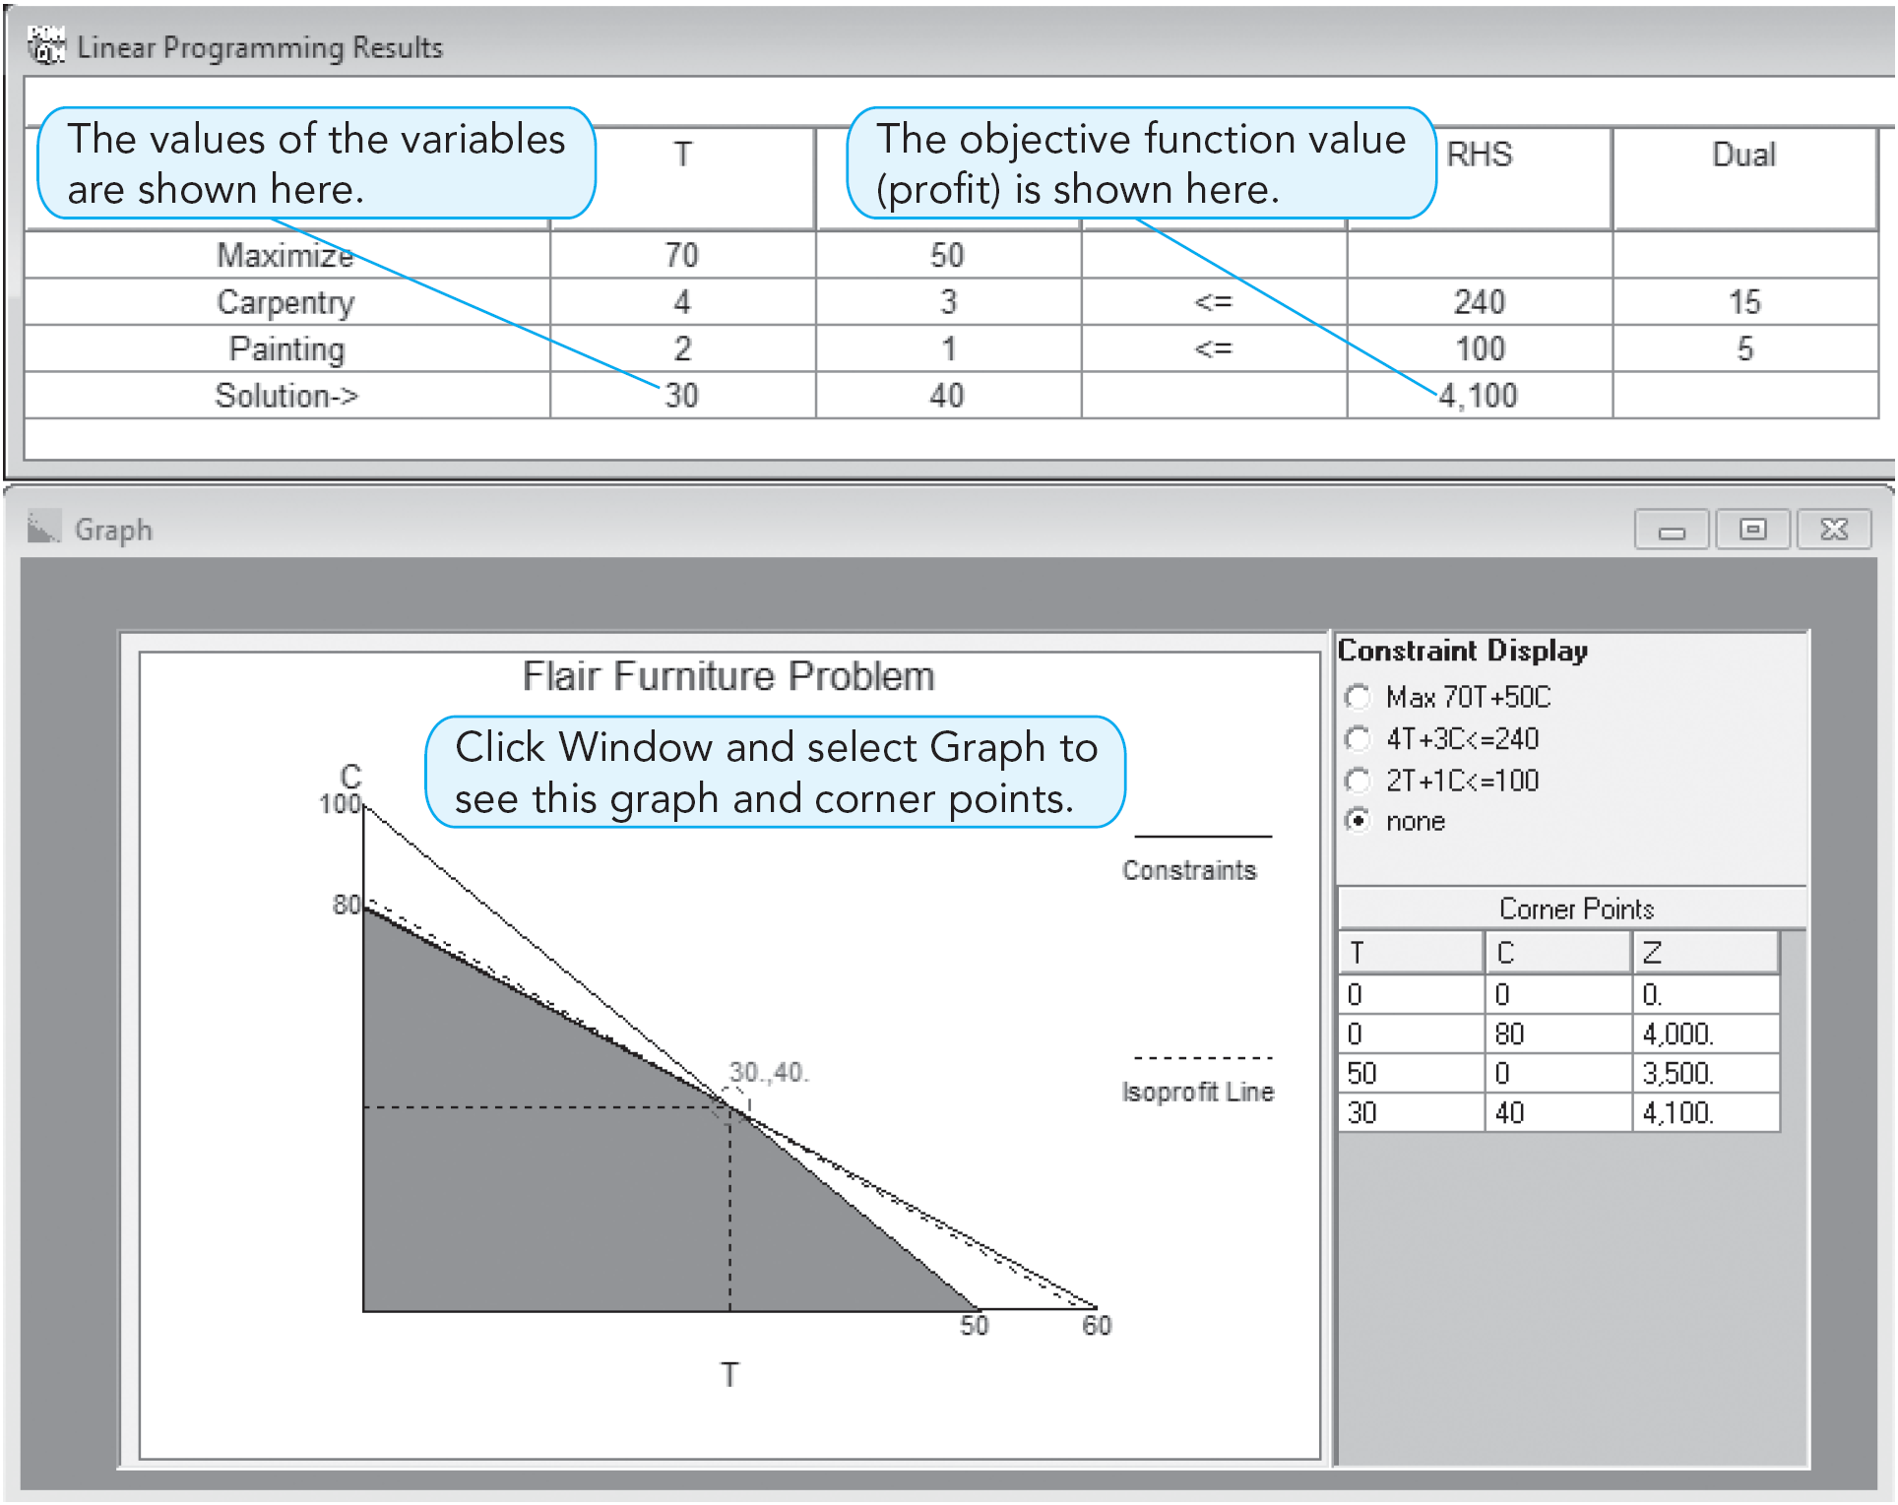
Using QM for Windows
PROGRAM 7.1C –
QM for Windows
Output and Graph

Slide 45
Using Excel’s Solver
The Solver tool in Excel can be used to find solutions to
LP problems
Integer programming problems
Noninteger programming problems
Solver is limited to 200 variables and, in some situations, 100 constraints

Slide 46
Using Solver
Recall the model for Flair Furniture is
Maximize profit = $70T + $50C
Subject to 4T + 3C ≤ 240
2T + 1C ≤ 100
To use Solver, it is necessary to enter data and formulas

Slide 47
Using Solver
Enter problem data
Variable names, coefficients for the objective function and constraints, RHS values for each constraint
Designate specific cells for the values of the decision variables
Write a formula to calculate the value of the objective function
Write a formula to compute the left-hand sides of each of the constraints

Slide 48
Using Solver
PROGRAM 7.2A – Excel Data Input

Slide 49
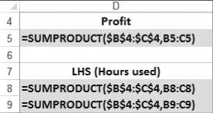
Using Solver
PROGRAM 7.2B – Formulas

Slide 50
Using Solver
PROGRAM 7.2C – Excel Spreadsheet

Slide 51
Using Solver
PROGRAM 7.2D – Starting Solver

Slide 52
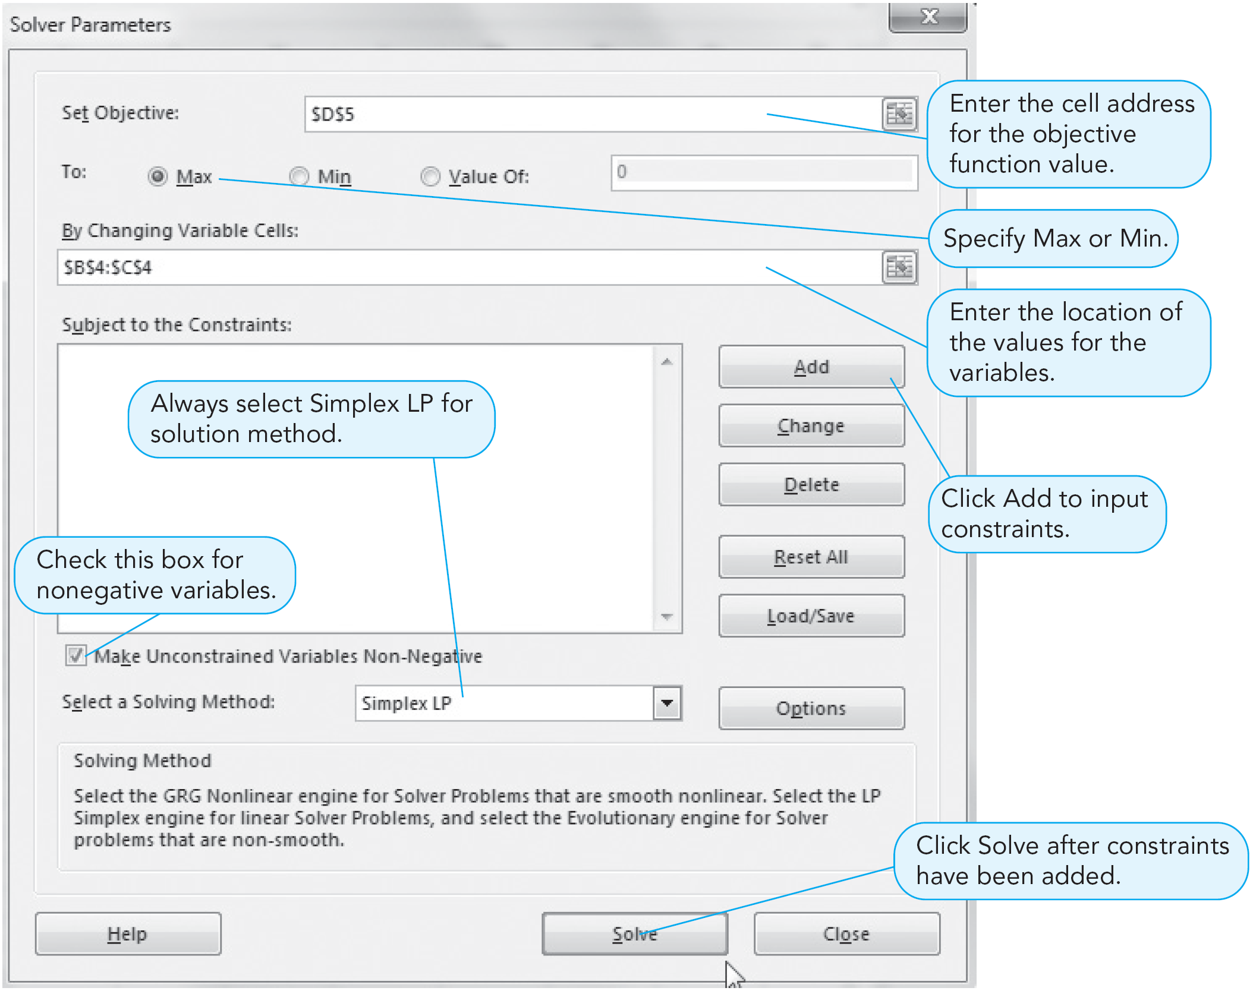
Using Solver
PROGRAM 7.2E –
Solver Parameters
Dialog Box

Slide 53
Using Solver
PROGRAM 7.2F – Solver Add Constraint Dialog Box

Slide 54
Using Solver
PROGRAM 7.2G – Solver Results Dialog Box

Slide 55
Using Solver
PROGRAM 7.2H – Solution

Slide 56
Using Excel QM
PROGRAM 7.3A –
Excel QM in Excel 2013

Slide 57
Using Excel QM
PROGRAM 7.3B – Excel QM Input Data

Slide 58
Using Excel QM
PROGRAM 7.3C – Excel QM Output

Slide 59
Solving Minimization Problems
Many LP problems involve minimizing an objective such as cost
Minimization problems can be solved graphically
Set up the feasible solution region
Use either the corner point method or an isocost line approach
Find the values of the decision variables (e.g., X₁ and X₂) that yield the minimum cost

Slide 60
Holiday Meal Turkey Ranch
The Holiday Meal Turkey Ranch is considering buying two different brands of turkey feed and blending them to provide a good, low-cost diet for its turkeys
TABLE 7.5 – Holiday Meal Turkey Ranch data
INGREDIENT | COMPOSITION OF EACH POUND OF FEED (OZ.) |  | MINIMUM MONTHLY REQUIREMENT PER TURKEY (OZ.)
 | BRAND 1 FEED | BRAND 2 FEED
A | 5 | 10 | 90
B | 4 | 3 | 48
C | 0.5 | 0 | 1.5
Cost per pound | 2 cents | 3 cents

Slide 61
Holiday Meal Turkey Ranch
Let
X₁ = number of pounds of brand 1 feed purchased
X₂ = number of pounds of brand 2 feed purchased
Minimize cost (in cents) = 2X₁ + 3X₂
subject to:
5X₁ + 10X₂ ≥ 90 ounces (ingredient A constraint)
4X₁ + 3X₂ ≥ 48 ounces (ingredient B constraint)
0.5X₁ ≥ 1.5 ounces (ingredient C constraint)
X₁ ≥ 0 (nonnegativity constraint)
X₂ ≥ 0 (nonnegativity constraint)

Slide 62
Holiday Meal Turkey Ranch
FIGURE 7.10 – Feasible Region
–
20 –
15 –
10 –
5 –
0 –
X₂
Ingredient C Constraint
Feasible Region
Pounds of Brand 2
a
Ingredient B Constraint
b
Ingredient A Constraint
c
| | | | | |
5 10 15 20 25
X₁
Pounds of Brand 1

Slide 63
Holiday Meal Turkey Ranch
Solve for the values of the three corner points
Point a is the intersection of ingredient constraints C and B
4X₁ + 3X₂ = 48
X₁ = 3
Substituting 3 in the first equation, we find X₂ = 12
Solving for point b we find X₁ = 8.4 and X₂ = 4.8
Solving for point c we find X₁ = 18 and X₂ = 0

Slide 64
Holiday Meal Turkey Ranch
Substituting these values back into the objective function we find
Cost = 2X₁ + 3X₂
Cost at point a = 2(3) + 3(12) = 42
Cost at point b = 2(8.4) + 3(4.8) = 31.2
Cost at point c = 2(18) + 3(0) = 36
The lowest cost solution is to purchase 8.4 pounds of brand 1 feed and 4.8 pounds of brand 2 feed for a total cost of 31.2 cents per turkey

Slide 65
Holiday Meal Turkey Ranch
Solving using an isocost line
Move the isocost line toward the lower left
The last point touched in the feasible region will be the optimal solution

Slide 66
Holiday Meal Turkey Ranch
FIGURE 7.11 – Graphical Solution Using the Isocost Approach
–
20 –
15 –
10 –
5 –
0 –
X₂
Feasible Region
Pounds of Brand 2
54¢ = 2X₁ + 3X₂ Isocost Line
Direction of Decreasing Cost
31.2¢ = 2X₁ + 3X₂
(X₁ = 8.4, X₂ = 4.8)
| | | | | |
5 10 15 20 25
X₁
Pounds of Brand 1

Slide 67
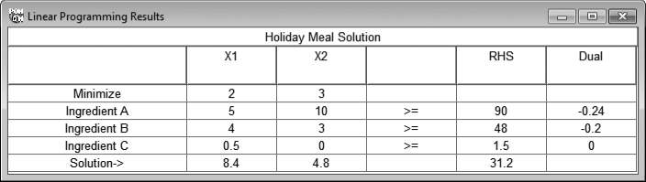
Holiday Meal Turkey Ranch
PROGRAM 7.4 – Solution in QM for Windows

Slide 68
Holiday Meal Turkey Ranch
PROGRAM 7.5A – Excel 2013 Solution

Slide 69
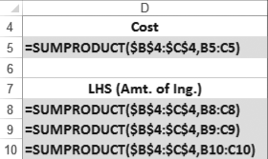
Holiday Meal Turkey Ranch
PROGRAM 7.5B – Excel 2013 Formulas

Slide 70
Four Special Cases in LP
Four special cases and difficulties arise at times when using the graphical approach
No feasible solution
Unboundedness
Redundancy
Alternate Optimal Solutions

Slide 71
No Feasible Solution
No solution to the problem that satisfies all the constraint equations
No feasible solution region exists
A common occurrence in the real world
Generally one or more constraints are relaxed until a solution is found
Consider the following three constraints

Slide 72
No Feasible Solution
FIGURE 7.12 – A problem with no feasible solution
X₂
8 –
–
6 –
–
4 –
–
2 –
–
0 –
Region Satisfying Third Constraint
| | | | | | | | | |
2 4 6 8
X₁
Region Satisfying First Two Constraints

Slide 73
Unboundedness
Sometimes a linear program will not have a finite solution
In a maximization problem
One or more solution variables, and the profit, can be made infinitely large without violating any constraints
In a graphical solution, the feasible region will be open ended
Usually means the problem has been formulated improperly

Slide 74
Unboundedness
FIGURE 7.13 – A Feasible Region That Is Unbounded to the Right
Maximize profit = | $3X₁ | + $5X₂
subject to | X₁ |  | ≥ 5
 |  | X₂ | ≤ 10
 | X₁ | + 2X₂ | ≥ 10
 |  | X₁, X₂ | ≥ 0
X₂
15 –
10 –
5 –
0 –
X₁ ≥ 5
X₂ ≤ 10
Feasible Region
X₁ + 2X₂ ≥ 10
| | | | |
5 10 15
X₁

Slide 75
Redundancy
A redundant constraint is one that does not affect the feasible solution region
One or more constraints may be binding
This is a very common occurrence in the real world
Causes no particular problems, but eliminating redundant constraints simplifies the model
Maximize profit = | $1X₁ | + $2X₂
subject to | X₁ | + X₂ | ≤ 20
 | 2X₁ | + X₂ | ≤ 30
 | X₁ |  | ≤ 25
 |  | X₁, X₂ | ≥ 0

Slide 76
Redundancy
FIGURE 7.14 – Problem with a Redundant Constraint
Maximize profit = | $1X₁ | + $2X₂
subject to | X₁ | + X₂ | ≤ 20
 | 2X₁ | + X₂ | ≤ 30
 | X₁ |  | ≤ 25
 |  | X₁, X₂ | ≥ 0
X₂
30 –
25 –
20 –
15 –
10 –
5 –
0 –
2X₁ + X₂ ≤ 30
Redundant Constraint
X₁ ≤ 25
X₁ + X₂ ≤ 20
Feasible Region
| | | | | |
5 10 15 20 25 30
X₁

Slide 77
Alternate Optimal Solutions
Occasionally two or more optimal solutions may exist
Graphically this occurs when the objective function’s isoprofit or isocost line runs perfectly parallel to one of the constraints
Allows management great flexibility in deciding which combination to select as the profit is the same at each alternate solution
Maximize profit = | $3X₁ | + $2X₂
subject to | 6X₁ | + 4X₂ | ≤ 24
 | X₁ |  | ≤ 3
 |  | X₁, X₂ | ≥ 0

Slide 78
Alternate Optimal Solutions
FIGURE 7.15 – Example of Alternate Optimal Solutions
Maximize profit = | $3X₁ | + $2X₂
subject to | 6X₁ | + 4X₂ | ≤ 24
 | X₁ |  | ≤ 3
 |  | X₁, X₂ | ≥ 0
X₂
8 –
7 –
6 –
5 –
4 –
3 –
2 –
1 –
0 –
A
Optimal Solution Consists of All Combinations of X₁ and X₂ Along the AB Segment
Isoprofit Line for $8
B
Isoprofit Line for $12 Overlays Line Segment AB
Feasible Region
| | | | | | | |
1 2 3 4 5 6 7 8
X₁

Slide 79
Sensitivity Analysis
Optimal solutions to LP problems thus far have been found under deterministic assumptions
We assume complete certainty in the data and relationships of a problem
Real world conditions are dynamic
Analyze how sensitive a deterministic solution is to changes in the assumptions of the model
This is called sensitivity analysis, postoptimality analysis, parametric programming, or optimality analysis

Slide 80
Sensitivity Analysis
Involves a series of what-if? questions concerning constraints, variable coefficients, and the objective function
Trial-and-error method
Values are changed and the entire model is resolved
Preferred way is to use an analytic postoptimality analysis
After a problem has been solved, we determine a range of changes in problem parameters that will not affect the optimal solution or change the variables in the solution

Slide 81
High Note Sound Company
The company manufactures quality speakers and stereo receivers
Products require a certain amount of skilled artisanship which is in limited supply
Product mix LP model
Maximize profit = | $50X₁ | + $120X₂
subject to | 2X₁ | + 4X₂ | ≤ 80 | (hours of electricians’ time available)
 | 3X₁ | + 1X₂ | ≤ 60 | (hours of audio technicians’ time available)
 |  | X₁, X₂ | ≥ 0

Slide 82
High Note Sound Company
FIGURE 7.16 – The High Note Sound Company Graphical Solution
X₂
(Receivers)
60 –
–
40 –
–
20 –
10 –
0 –
Optimal Solution at Point a
X₁ = 0 Speakers
X₂ = 20 Receivers
Profits = $2,400
a = (0, 20)
b = (16, 12)
Isoprofit Line: $2,400 = 50X₁ + 120X₂
| | | | | |
10 20 30 40 50 60
X₁
c = (20, 0)
(Speakers)

Slide 83
High Note Sound Company
Electrician hours used are
2X₁ + 4X₂ = 2(0) + 4(20) = 80
All hours are utilized so slack = 0
Additional units of a binding constraint will generally increase profits
Technician hours used are
3X₁ + 1X₂ = 3(0) + 1(20) = 20
Available hours = 60 so slack = 60 – 20 = 40
Additional units of a nonbinding constraint will only increase slack

Slide 84
Changes in the Objective Function Coefficient
Contribution rates in the objective functions fluctuate
The feasible solution region remains exactly the same
The slope of the isoprofit or isocost line changes
Modest increases or decreases in objective function coefficients may not change the current optimal corner point
Know how much an objective function coefficient can change before the optimal solution would be at a different corner point

Slide 85
Changes in the Objective Function Coefficient
FIGURE 7.17 – Changes in the Receiver Contribution Coefficients
40 –
30 –
20 –
10 –
0 –
X₂
Profit Line for 50X₁ + 80X₂
(Passes through Point b)
Old Profit Line for 50X₁ + 120X₂
(Passes through Point a)
b
a
Profit Line for 50X₁ + 150X₂
(Passes through Point a)
c
| | | | | |
10 20 30 40 50 60
X₁

Slide 86
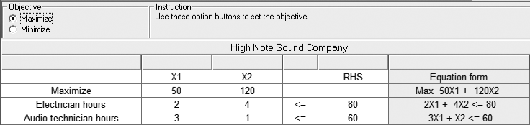
QM for Windows
PROGRAM 7.6A – Input to QM for Windows High Note Sound

Slide 87
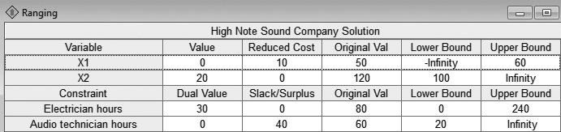
QM for Windows
PROGRAM 7.6B – High Note Sound Sensitivity Analysis

Slide 88
Excel Solver
PROGRAM 7.7A – Excel Spreadsheet for High Note Sound

Slide 89
Excel Solver
PROGRAM 7.7B – Excel 2013 Solution and Solver Results

Slide 90
Excel Solver
PROGRAM 7.7C –
Excel 2013
Sensitivity Report

Slide 91
Changes in the Technological Coefficients
Changes in the technological coefficients often reflect changes in the state of technology
If the amount of resources needed to produce a product changes, coefficients in the constraint equations will change
Objective function does not change
May produce significant change in the shape of the feasible region
May cause a change in the optimal solution

Slide 92
Changes in the Technological Coefficients
FIGURE 7.18 – Change in the Technological Coefficients
(a) Original Problem
(b) Change in Circled Coefficient
(c) Change in Circled Coefficient
60 –
40 –
20 –
60 –
40 –
20 –
60 –
40 –
20 –
X₂
X₂
X₂
3X₁ + 1X₂ ≤ 60
2 X₁ + 1X₂ ≤ 60
3X₁ + 1X₂ ≤ 60
Stereo Receivers
Optimal Solution
Still Optimal
Optimal Solution
a
a
b
d
16
f
2X₁ + 4X₂ ≤ 80
2X₁ + 4X₂ ≤ 80
g
2X₁ + 5 X₂ ≤ 80
c
e
c
| | |
0 20 40
| | |
0 20 40
| | |
0 20 40
|
30
X₁
X₁
X₁
CD Players

Slide 93
Changes in Resources or Right-Hand-Side Values
Right-hand-side values of the constraints often represent resources available to the firm
Additional resources may lead to higher total profit
Sensitivity analysis about resources helps answer questions about
How much should be paid for additional resources
How much more of a resource would be useful

Slide 94
Changes in Resources or Right-Hand-Side Values
Changing the RHS will change the feasible region, unless the constraint is redundant
Often changes the optimal solution
The dual price or dual value
The amount of change in the objective function value that results from a unit change in one of the resources
The dual price for a constraint is the improvement in the objective function value that results from a one-unit increase in the right-hand side of the constraint

Slide 95
Changes in Resources or Right-Hand-Side Values
The amount of possible increase in the RHS is limited
If the RHS is increased beyond the upper bound, then the objective function would no longer increase by the dual price
There would be excess (slack) resources or the objective function may change by an amount different from the dual price
The dual price is relevant only within limits

Slide 96
Changes in the Electricians’ Time Resource
FIGURE 7.19
60 –
40 –
20 –
X₂
(a)
Constraint Representing 60 Hours of Audio Technician’s Time Resource
25 –
a
b
Changed Constraint Representing 100 Hours of Electrician’s Time Resource
c
| | |
0 20 40 60
|
50
X₁

Slide 97
Changes in the Electricians’ Time Resource
FIGURE 7.19
60 –
40 –
20 –
X₂
(b)
Constraint Representing 60 Hours of Audio Technician’s Time Resource
25 –
Changed Constraint Representing 60 Hours of Electrician’s Time Resource
a
b
c
| | |
0 20 40 60
|
50
X₁

Slide 98
Changes in the Electricians’ Time Resource
FIGURE 7.19
60 –
40 –
20 –
X₂
(c)
Changed Constraint Representing 240 Hours of Electrician’s Time Resource
Constraint Representing 60 Hours of Audio Technician’s Time Resource
25 –
| | | | | |
0 20 40 60 80 100 120
X₁

Slide 99
QM for Windows
PROGRAM 7.6B – High Note Sound Sensitivity Analysis

Slide 100
Excel Solver
PROGRAM 7.7C –
Excel 2013
Sensitivity Report

